Slide 1


QUADRUPED ROBOTICS
Supervised by:
Inaki Vázquez Gomez
Asier González Santocildes
Presented by:
HEEHYEONG Nam
WISSAL Bouksaim
Manal El Kachach

Slide 2



Introduction
REALISM:
Simulates real-world challenges like balance, coordination, and efficiency.
RELEVANCES:
Quadruped robots are widely used in applications such as:
Rescue missions
Package delivery
Exploration in difficult terrains
Highlights their potential in navigating streets and staircases efficiently.
2

Slide 3

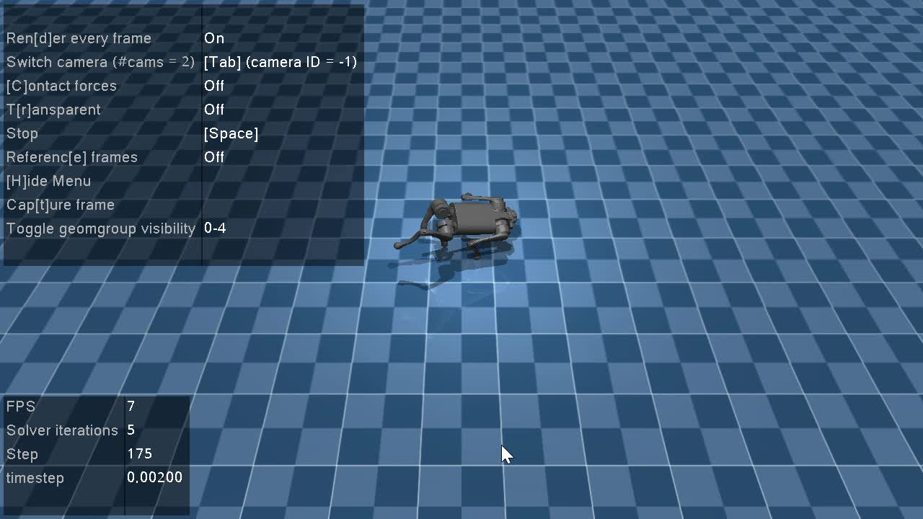
Environment Setup
Step 1: Environment Configuration
Followed the official documentation from Gymnasium to set up the environment.
Model used: Ant-v5.
Step 2: Testing the Environment
Ran a test episode with random actions:
3

Slide 4
Algorithms Used
Environment Analysis:
Continuous State Space: The agent operates in an environment where states change continuously.
Continuous Action Space: Actions are not discrete but continuous values.
PPO
SAC
A robust and scalable policy gradient method.
Effective for environments with continuous action spaces.
A state-of-the-art RL algorithm for continuous action spaces.
Leverages entropy regularization for better exploration.
4

Slide 5

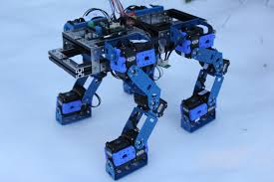
PROXIMAL POLICY OPTIMIZATION
(PPO)
5

Slide 6
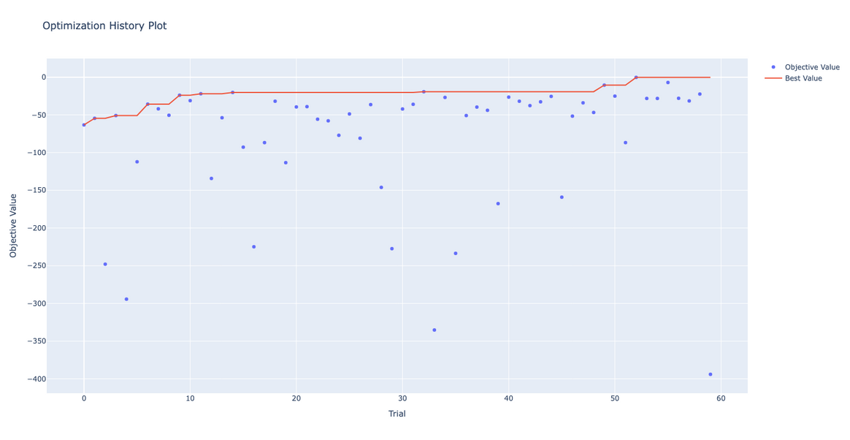
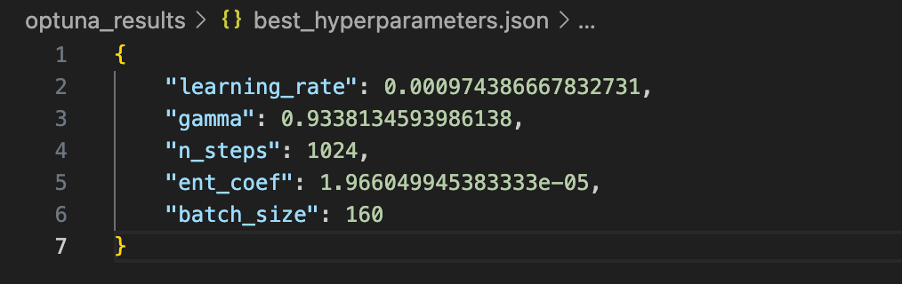
1. OPTIMIZING HYPERPARAMETERS
?PPO Algorithm
Optimizing hyperparameters
Modifying environmental setup
Analysis
6

Slide 7
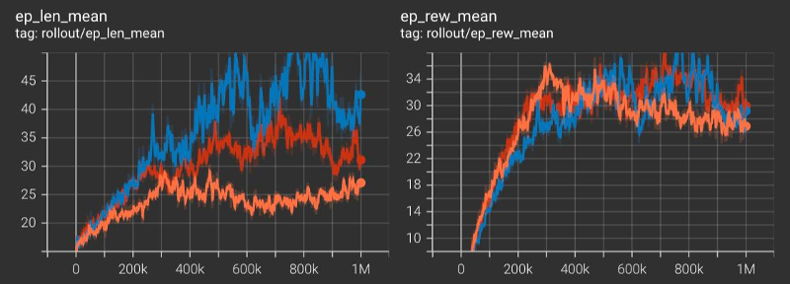
2. MODIFYING ENVIRONMENTAL SETUP
frw = 1
frw = 1.2
frw = 1.5
Forward_reward_weight = {1, 1.2, 1.5}
To know the impact of this environmental setup on the training of agent
The final rewards across experiments remain consistent in the range of 28–34
7

Slide 8
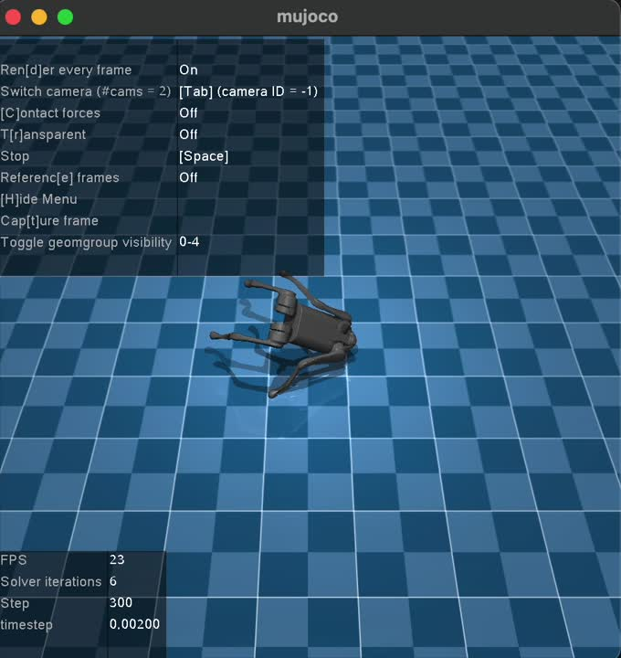
3. ANALYSIS
The later fluctuations and slight declines in rewards are interpreted as challenges in balancing exploration and exploitation or overfitting to specific strategies that are less robust
The agent showed imbalanced action even if the forward_reward_weight is 1 (default value). So probably it’s because of the overfitting by optimization of hyperparameter
Fine-tuning may be required to reduce instability at later stages
=> Higher forward_reward_weight made the length of episode shorter but caused instable fluctuation of mean reward
8

Slide 9
SOFT ACTOR-CRITIC
(SAC)
9

Slide 10
After training with PPO, we switched to SAC for its superior handling of continuous action spaces and entropy-regularized exploration. SAC's balanced approach to exploration and exploitation allowed our agent to achieve higher rewards and better adapt to the environment's challenges, outperforming PPO
?SAC Algorithm
Training agent
Rewards & Analysis
Optimizing hyperparameter
TensorBoard Metrics
10

Slide 11

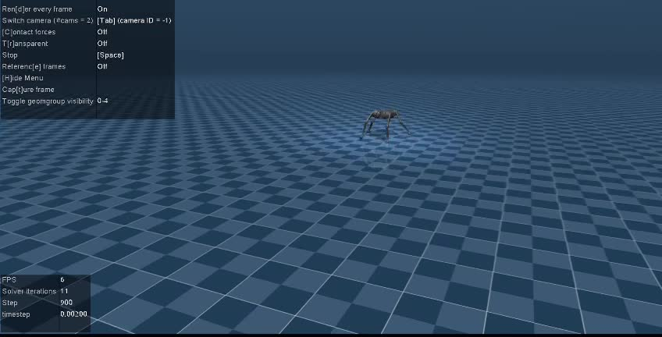
TRAINING AGENT(FORWARD_REWARD_WEIGHT=1)
11

Slide 12
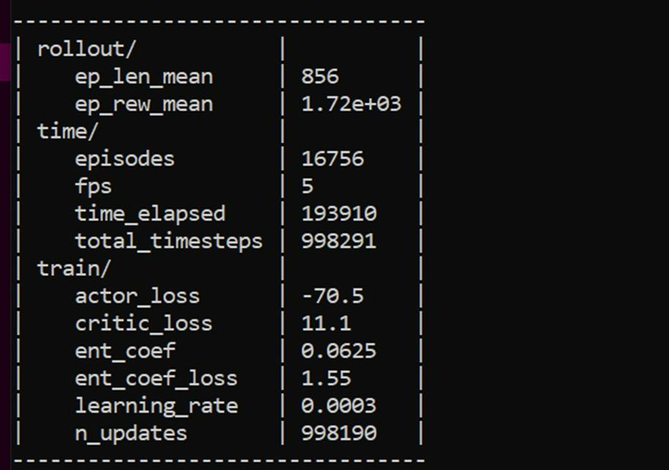
REWARDS & ANALYSIS
The SAC algorithm achieved a high mean reward of 1723 and a long episode length of 856, demonstrating its robustness and efficiency. Stable training metrics indicate the agent successfully learned an optimal policy, with the low FPS reflecting the computational complexity of the environment.
12

Slide 13
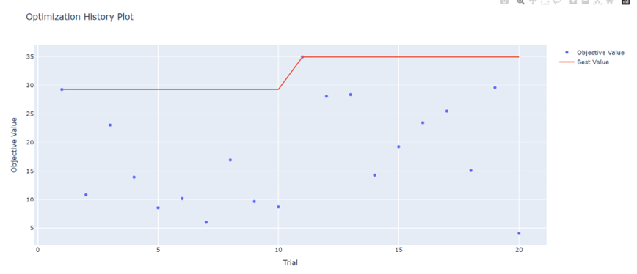
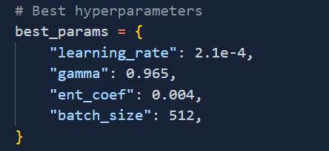
OPTIMIZING HYPERPARAMETER
13

Slide 14
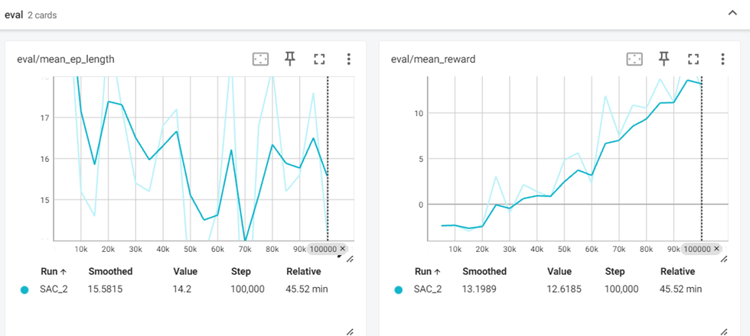
TENSORBOARD METRICS
14

Slide 15
SAC + CURRICULUM
15

Slide 16
Why Curriculum Learning?
Helps the agent adapt progressively to more challenging environments.
Our Strategy:
Initial Setup: Start with an easy task.
healthy_z_range = (0.2, 0.75)
Progressive Difficulty:
Every 100,000 timesteps, reduce the lower limit of healthy_z_range by 0.01.
Stop adjustments when the lower limit reaches 0.195.
Final Phase:
Continue training with the hardest version of the task until reaching 1,000,000 timesteps.
Curriculum Learning strategy
16

Slide 17
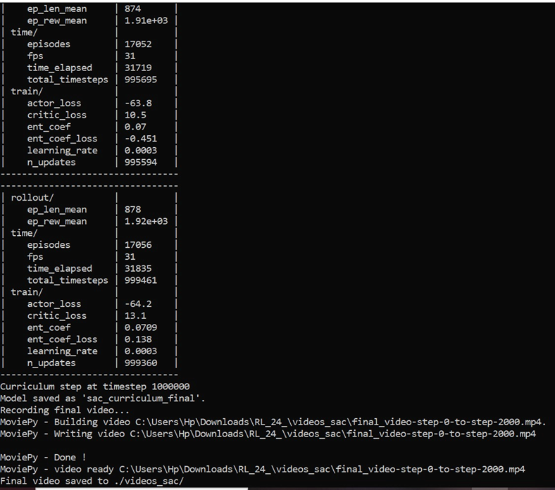
TRAINING RESULTS
After implementing Curriculum Learning, the SAC agent achieved a new reward of 1913, an improvement over the baseline of 1723.
17

Slide 18
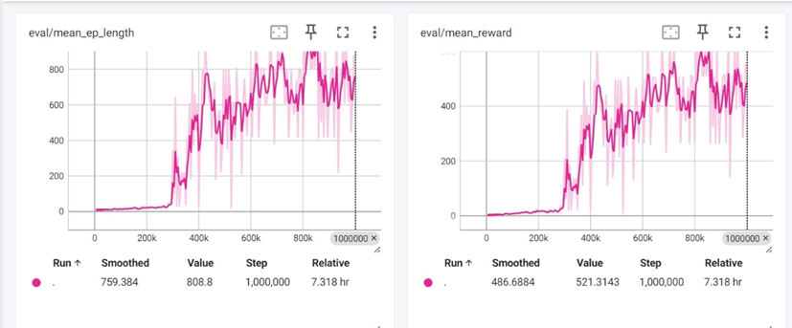
TENSORBOARD
Gradual increase, peaking at ~521 after 1,000,000 timesteps.
Highlights the effectiveness of curriculum learning in maximizing performance.
Episode length increased steadily, stabilizing at 808 steps, reflecting the agent's ability to adapt to harder tasks over time.
18

Slide 19
SAC + OPTUNA
19

Slide 20

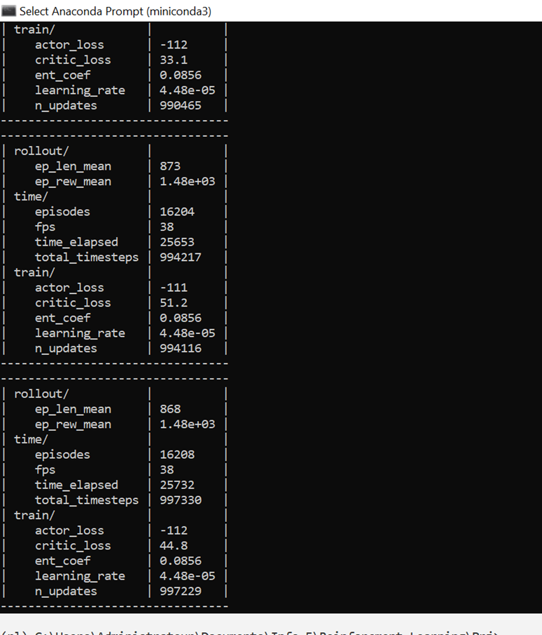

RESULTS
Optimization Process:
Conducted 20 trials using Optuna to identify the best hyperparameters.
Each trial involved training and evaluating the agent's performance.
Best Hyperparameters:
learning_rate: 2.1e-4
gamma: 0.965
tau: 0.012
ent_coef: 0.004
batch_size: 512
20

Slide 21

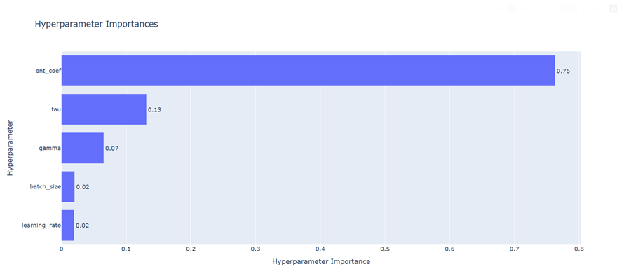
OPTUNA PLOTS
Displays the objective values (rewards) for each trial.
Highlights improvements across 20 trials, with the best value stabilizing after trial 10.
Shows the contribution of each hyperparameter to the performance of the SAC agent.
Entropy Coefficient (ent_coef) emerged as the most critical parameter (importance: 0.76).
21

Slide 22

THANK YOU FOR YOUR ATTENTION

